Slide 1

Introduction to Physics II
(Spring Semester 2018)
Course Information
Department of Physics
Shiv Nadar University

Slide 2
Course Title: Introduction to Physics-II
Course Code: PHY102
Course schedule
Lectures: Tuesdays and Thursdays (10:30 – 11:55 PM)
Venue for lectures: D217
Tutorials: Tuesdays (5:00 – 6:00 PM), Thursdays (5:00 – 6:00 PM)
Check time-tables for various groups at each time slots and their venues
Labs: Monday (2:00-5:00 PM), Wednesday (2:00 – 5:00 PM), Friday (2:00 – 5:00 PM)
Venue: A-wing (A101), First floor, Physics lab

Slide 3
Instructor Details:
Dr. Bhaskar Kaviraj
Office: A017C (A-wing, First floor)
Email Address: bhaskar.kaviraj@snu.edu.in
Dr. Syed Kamil
Office: A023 (A-wing, First floor)
Email Address: syed.kamil@snu.edu.in

Slide 4
Aims:
To bridge the gap between (10+2) level and undergraduate level.
To develop an understanding of basic physical laws and skills to apply various physical concepts to natural and engineering systems through problem solving.

Slide 5
Course outline and syllabus
Vector Calculus:
Fundamental vector operations, Vector calculus: Gradient, Divergence, Curl and related fundamental theorems of vector calculus, Vector integration (line, surface and volume integrals), Divergence theorem and Stoke’s theorem, Coordinate systems (Polar (2D), Spherical and Cylindrical (3D)).
Electrostatics
Electric field, divergence and curl of electric fields, electric potential, Work and Energy in electrostatics, conductors and capacitors, Laplace’s equation of electrostatic potential in 1, 2 and 3 dimensions, Multipole expansion of electrostatic potential, monopole and dipole terms, field due to electric dipole, polarization in dielectrics, field of a polarized object, bound charges and its physical interpretation, electric displacement vector and Gauss’s law in dielectrics, definitions of permittivity, susceptibility and dielectric constant

Slide 6
Magnetostatics
Magnetic forces and Lorentz force law, charged particle in an electromagnetic field, magnetic field due to steady current (Biot-Savart law), Divergence and Curl of B, Ampere’s law (differential and integral form), magnetic dipole, forces and torque on a current carrying loop, magnetic field due to a magnetic dipole, magnetic vector potential, effect of magnetic field on atomic orbits, magnetzation, field of a magnetized object, bound currents and their physical interpretation, auxiliary field H, Ampere’s law in magnetized materials
Electrodynamics
Electromotive force, Ohm’s law, motional emf, Faraday’s law of electromagnetic induction and induced electric field, self and mutual inductance, energy in magnetic fields, Maxwell’s equations before and after Maxwell, displacement currents, work-energy theorem (Poynting’s theorem) in electrodynamics, Poynting’s vector, continuity equation, electromagnetic waves in vacuum, monochromatic plane electromagnetic waves and their representation

Slide 7
Wave Optics:
Interference of light waves: Young’s double slit experiment, displacement of fringes, Interference in thin films.
Diffraction: Fresnel’s and Fraunhofer’s class of diffraction, diffraction from single, double & N- Slits.
Polarization: Concept of Polarization in electromagnetic waves, types of polarized waves, Production and analysis of polarized light, Phenomena of double refraction.

Slide 8
Further details:
Attendance requirements:
75% (minimum as per SNU’s policy)
Course pre-requisite (flexible):
Reasonably good Mathematical background (calculus, differential equations, algebra, geometry, graphical analysis, co-ordinate system, transformation of coordinate systems, vectors, vector calculus).
Text /reference books:
1. Introduction to Electrodynamics, D. J. Griffith
2. Physics for Scientists and Engineers with Modern Physics, J. W. Jewett and R. A. Serway
3. Feynman Lecture series, Vol. 2.
4. Classical electrodynamics, J. D. Jackson

Slide 9
Course evaluation scheme:
- One mid semester exam: 20%
- Two quizzes + Surprise quizzes: (total, 20%)
- Lab: 15% (Lab classes) + 10% (Lab Exam.) (Total 25%)
- End-semester examination: 35%
- Minimum passing marks (Abs. scale): 40%
Syllabus for exams:
For mid sems.: Topics covered upto one week before the scheduled examinations.
End sem (Final): Remaining topics (60-70% questions can be expected)+ Mid-sem syllabus (30-40%)
All quizzes (30 minutes quiz): One/two questions based on selected topics/chapters would be asked. Syllabus would be notified in advance.

Slide 10
Schedule for exams and quizzes:
• Quiz 1: 2nd Feb. 2018 (Friday)
• Mid-sem exam: 5th-8th Mar (specific date to be announced from Dean Office)
• Quiz 2: 5th Apr 2018 (Thu)
• Lab. exam: 9th – 21st April 2018
• End sem exam: 3rd May – 12th May

Slide 11
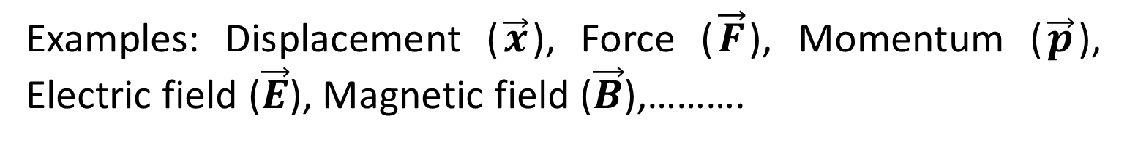
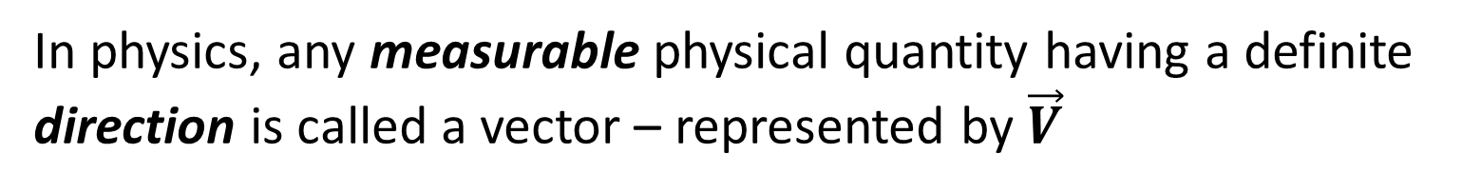
What are vectors?
In physics, any measurable physical quantity having a definite direction is called a vector – represented by $\vec{V}$
(crude definition)
Examples: Displacement ($\vec{x}$), Force ($\vec{F}$), Momentum ($\vec{p}$), Electric field ($\vec{E}$), Magnetic field ($\vec{B}$),……….
Many algebraic operations can be performed on vectors such as addition, subtraction, multiplication just like mathematical numbers
In physics, there are two interesting operations involving vectors. They are Dot Product and Cross Product (already completed in PHY101)

Slide 12
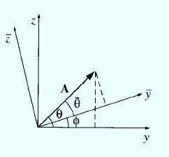
A physicist’s definition of vector
Any set of three components which combines properly on addition and transforms according to a specific transformation law from one frame of reference (coordinate axes) to another
Notes:
Components of A in (x-y-z) frame of reference changes, not in an arbitrary manner but under a specific transformation law, when you change the co-ordinate axes to $\overline{x},\overline{y},\overline{z}$

Slide 13
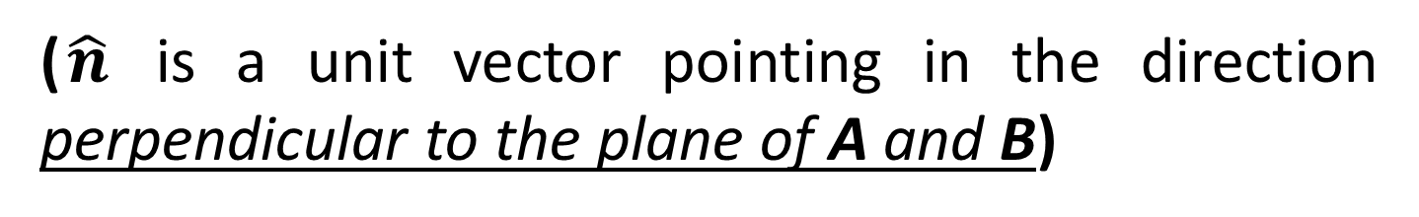

Cross product of two vectors
The cross product of two vectors is defined by
$$A×B=ABsinθ\hat{n}$$
($\hat{n}$ is a unit vector pointing in the direction perpendicular to the plane of A and B)
Ambiguity: There are two directions perpendicular to any given plane – either pointing ‘in’ the plane or pointing ‘out’ of plane

Slide 14
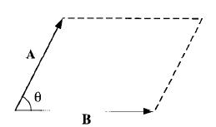
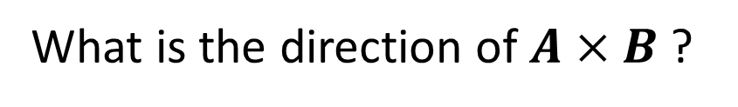
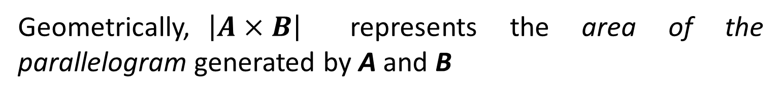
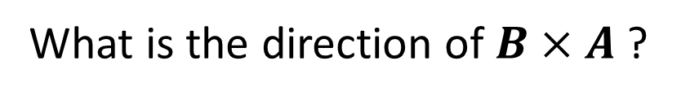
Cross product of two vectors
Right hand rule: Imagine you are rotating a screw in a direction from the first vector to the second (two vectors having a common origin) via the smaller angle- direction of the screw would give you the direction of the cross product.
What is the direction of $A×B$ ?
What is the direction of $B×A$ ?
Geometrically,$\left|A×B\right|$ represents the area of the parallelogram generated by A and B

Slide 15
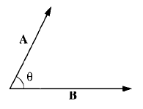



Dot product of two vectors
The dot product of two vectors is given by
$$A∙B=ABcosθ$$
Dot product is a scalar quantity (hence it is also called a scalar product)
Geometrically, A.B is the product of A times the projection of B along A (or the product of B times the projection of A along B)
If two vectors are parallel, then
$$A∙B=AB$$
If two vectors are perpendicular, then
$$A∙B=0$$

Slide 16
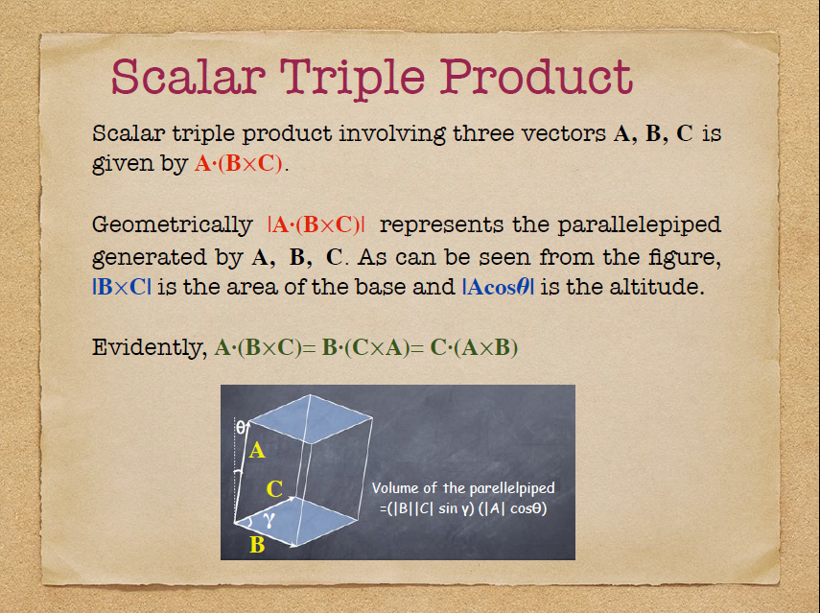

Slide 17
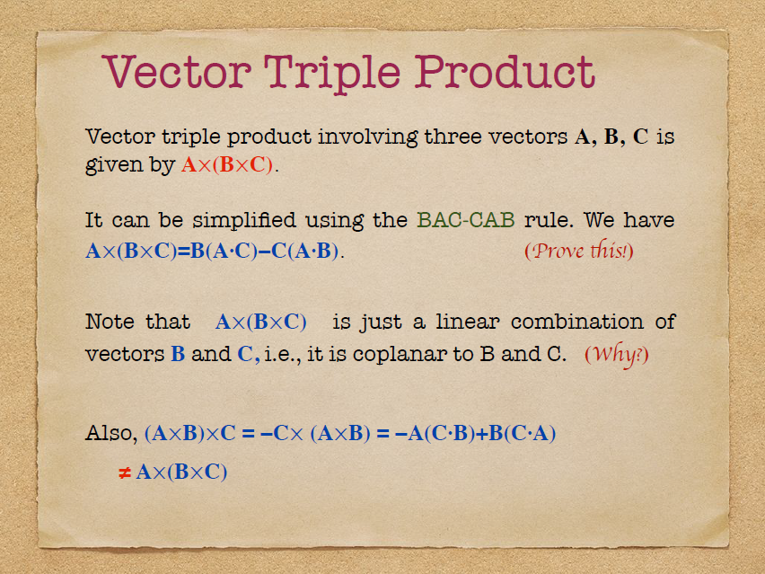

Slide 18
